Slide 1
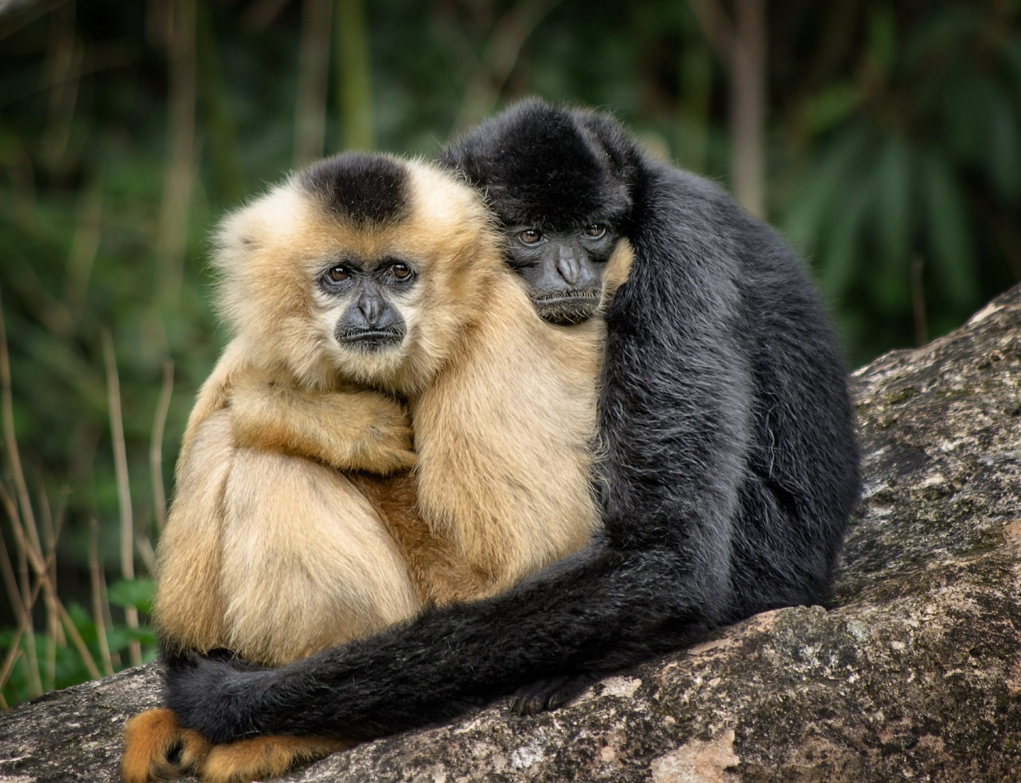
Influences on relationship expectations
LO: Lesson 3

Slide 2

Group Agreement
Notes:
Staff should go through this slide and create a group agreement in the first RSHE lesson of the academic year. It is recommended that this is done in the following way:
Discuss and agree as a group. Teacher creates the document in the template for all pupils to stick into book the next lesson.
The Group Agreement should then be visited during the start of each lesson along with the slides on Protected Characteristics, SMSC and British Values.

Slide 3

Protected Characteristics?
Protected characteristics are aspects of a person’s identity that are protected under the Equality Act 2010. This law makes it illegal to discriminate against someone based on these characteristics, helping to promote a fairer and more equal society.
Notes:
Teaching staff should go over the protected characteristics at the start of every lesson, and ensure that the language of the classroom reflects these characteristics.

Slide 4

At UALS we continually promote the values that underpin SMSC. These values form the foundations on which the RSHE curriculum has been designed and in the ways we teach and learn.
The concept of SMSC will be used to promote and develop our pupils understanding of British Values throughout their RSHE Learning Journey.

Slide 5
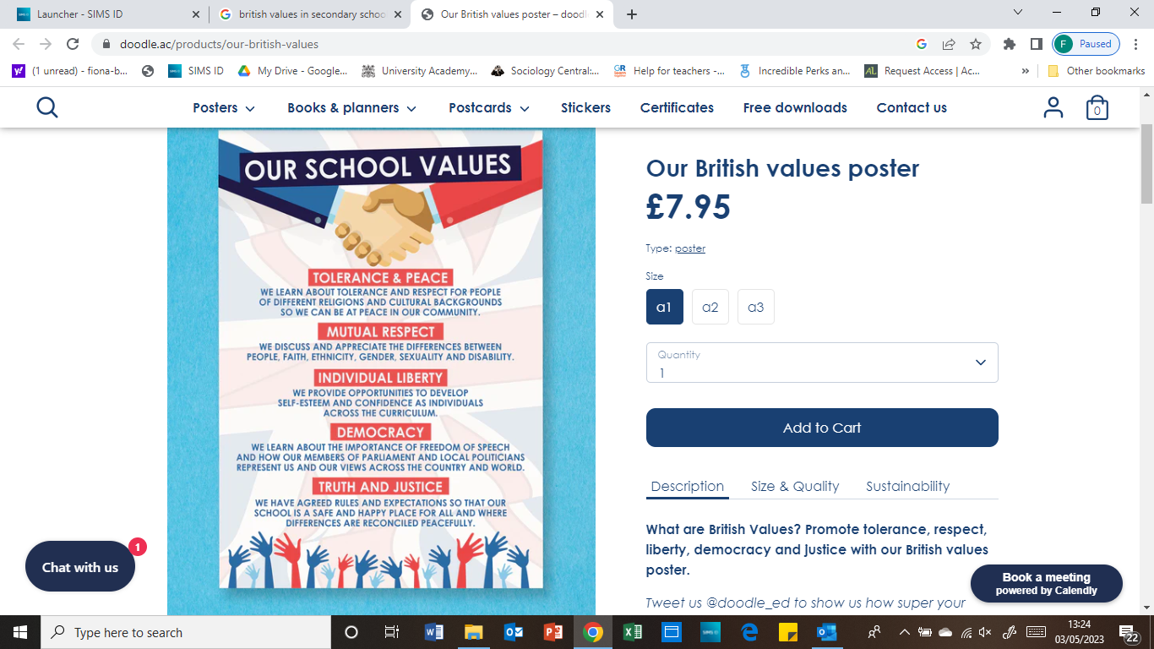
British Values in RSHE
Notes:
Teaching staff should talk pupils through this slide every lesson.

Slide 6
Last lesson | 2 | Relationship Values | to develop realistic and healthy relationship values and expectations.
This lesson | 3 | Influences on Relationship Expectations | Assess how to challenge unrealistic relationship expectations.
Next Lesson | 4 | Sexual Orientation and Gender Identity | to understand and respect the spectrum of gender identities and sexual orientations.

Slide 7
Values
Read the statement and decide if you agree or disagree with it.
If you think it depends, write what you think it would depend on in the middle column on your sheet.
Agree
Depends on…
Disagree
Share your views with others and identify any points of disagreement.

Slide 8


Sending nudes
Jasmin is 13. She met her partner, who is 15, online and they have been going out for three weeks.
She’s sent them some pictures, but they keep hinting they’d like to see more of her body.
How might Jasmine be feeling?
What might Jasmine be thinking?

Slide 9

Sending nudes: advice
Work in groups to imagine you are a group of Jasmine’s friends.
What could you say to reassure Jasmine?
What could you advise Jasmine to do?

Slide 10

Sending nudes
Taylor is 15. All their friends say they’ve had sex and have shared loads of sexy photos to prove it.
Taylor feels pressure to get photos from their partner to share too.
How might Taylor be feeling?
What might Taylor be thinking?

Slide 11
Sending nudes: advice
Work in groups to imagine you are a group of Taylor’s friends.
What could you say to reassure Taylor?
What could you advise Taylor to do?

Slide 12
Comparing the scenarios
Jasmin is 13. She met her partner, who is 15, online and they have been going out for three weeks.
She’s sent them some pictures, but they keep hinting they’d like to see more of her body.
Taylor is 15. All their friends say they’ve had sex and have shared loads of sexy photos to prove it.
Taylor feels pressure to get photos from their partner to share too.
Does anything strike you about the two scenarios?

Slide 13

Gender expectation stereotypes
Using the titles around the room, draw and write any gender stereotypes or news stories you are familiar with.
Include an explanation of why such stereotypes or incidents are unacceptable.
Sports and leisure time
Clothing
Job roles
Behaviour and traits
Remember the ground rules: avoid offensive terms

Slide 14


Helping a friend
Using the worksheet, offer advice and support to a friend.

Slide 15

Signposting support
If you would like further guidance or support:
speak to a parent/carer, tutor, head of year, school nurse/counsellor or other trusted member of staff in the school
Visit:
A Better Medway: www.abettermedway.co.uk
Brook: www.brook.org.uk/help-advice
Childline: www.childline.org.uk 0800 1111

Slide 16


More activities
Ten points I have learned
List 10 points about sending nudes or the influence of the media (could be facts, consequences, legal issues etc.). Share the list with the rest of your group and use their feedback to refine your list.
Can you explain the law relating to the sharing of sexual images to a partner?
Video resources
Watch the film Sending nudes ft. Beauty Spectrum and discuss the issues raised. You could create a class list of reasons for and against sending nude images.

