Slide 1
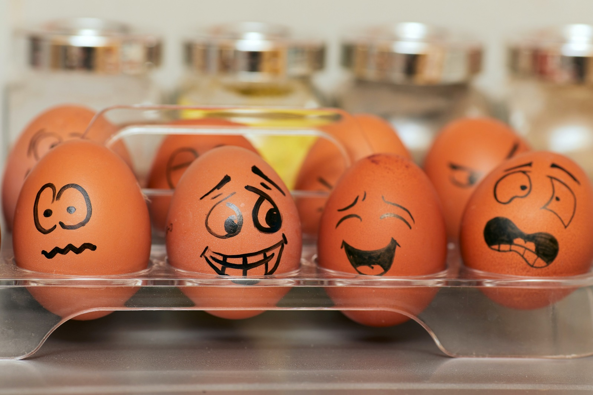
Puberty and emotional changes
LO: Lesson 1

Slide 2

Group Agreement
Notes:
Staff should go through this slide and create a group agreement in the first RSHE lesson of the academic year. It is recommended that this is done in the following way:
Discuss and agree as a group. Teacher creates the document in the template for all pupils to stick into book the next lesson.
The Group Agreement should then be visited during the start of each lesson along with the slides on Protected Characteristics, SMSC and British Values.

Slide 3
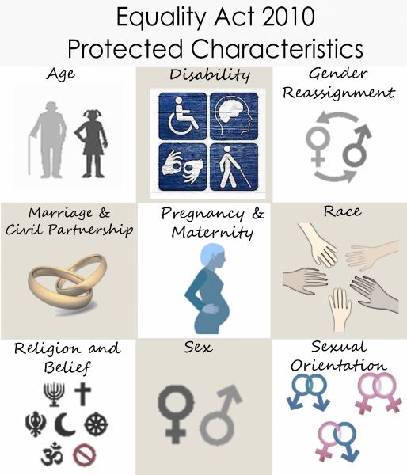
Protected Characteristics?
Protected characteristics are aspects of a person’s identity that are protected under the Equality Act 2010. This law makes it illegal to discriminate against someone based on these characteristics, helping to promote a fairer and more equal society.
Notes:
Teaching staff should go over the protected characteristics at the start of every lesson, and ensure that the language of the classroom reflects these characteristics.

Slide 4

At UALS we continually promote the values that underpin SMSC. These values form the foundations on which the RSHE curriculum has been designed and in the ways we teach and learn.
The concept of SMSC will be used to promote and develop our pupils understanding of British Values throughout their RSHE Learning Journey.

Slide 5
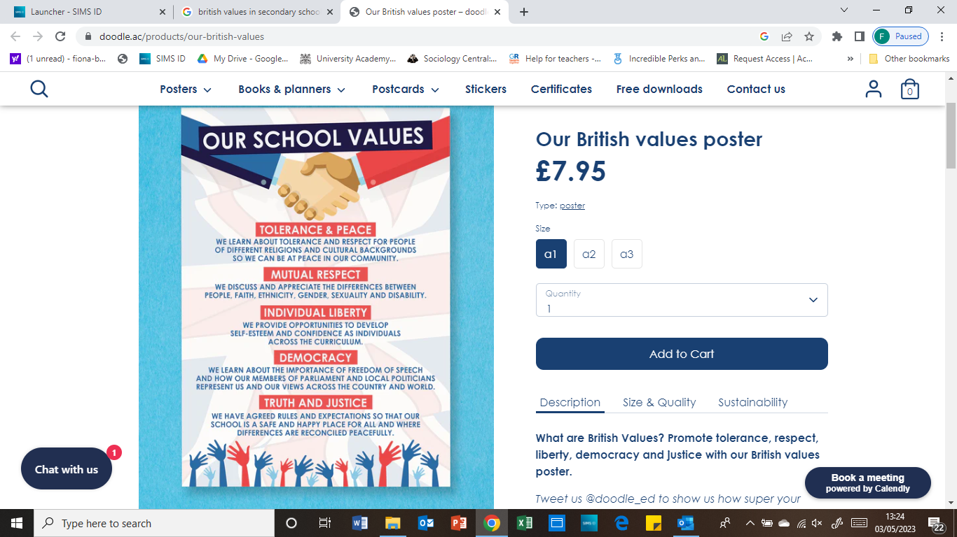
British Values in RSHE
Notes:
Teaching staff should talk pupils through this slide every lesson.

Slide 6
This lesson | 1 | Puberty and emotional Change | understand how the emotions are affected by puberty, how this may affect relationships and how to manage this.
Next lesson | 2 | Relationship Values | to develop realistic and healthy relationship values and expectations.
Lesson after | 3 | Influences on Relationship Expectations | Assess how to challenge unrealistic relationship expectations.

Slide 7
Learning objective
We are learning about how the emotions are affected by puberty, how this may affect relationships and how to manage this.
Learning outcomes
I can describe the main physical and emotional changes experienced during puberty
I can evaluate how relationships can be affected during puberty
I have strategies for managing the emotional aspects of puberty

Slide 8

Ground rules

Slide 9

Anonymous question box
On a piece of paper, write at least one question you have relating to these topics:
consent
menstrual wellbeing
managing relationship conflict
healthy relationships
puberty and how relationships might change during puberty

Slide 10

Scenarios
Can you respond to the scenarios?

Slide 11
What is ‘puberty’?
Puberty is the stage in someone's life when they develop from a child into an adult because of changes in their body that make them able to have children. These physical changes are accompanied by changes that can affect emotions as hormones change and people’s identities develop.
How might relationships change during or after puberty?

Slide 12
Changes during puberty
Sort the cards to show the different types of physical changes young people experience during puberty:
Biologically male
Can affect anyone
Biologically female

Slide 13
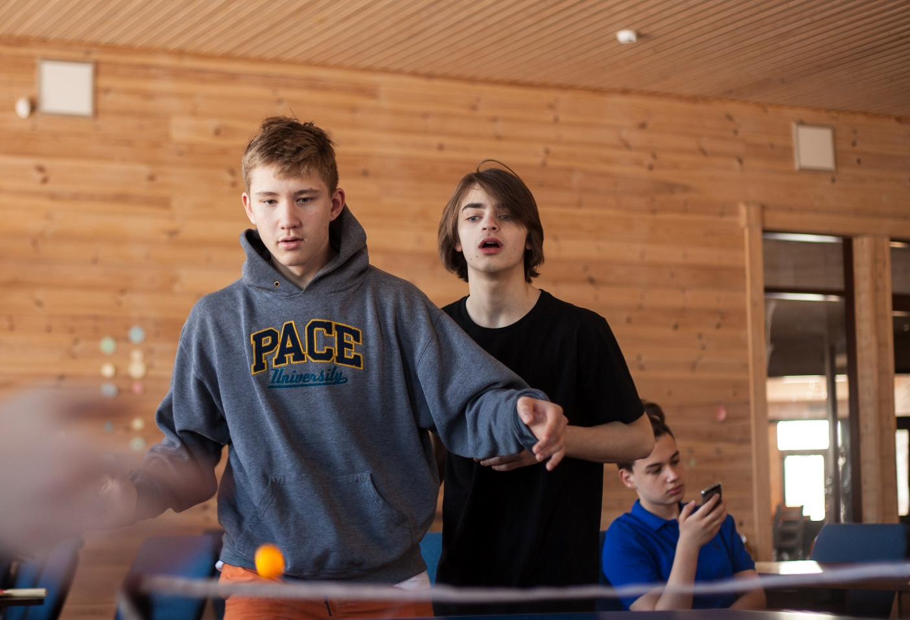
Changes during puberty
Which of these changes are likely to affect the relationship young people have with others?
(This might include friends, family, or romantic relationships).
Mood seems to change a lot
Sexual feelings may begin
Confusion about maturity
Feeling intense emotions
Can feel teary or angry for no reason

Slide 14

Managing relationships during puberty
In your groups, pick a scenario and give advice to the character about what they should do next.

Slide 15
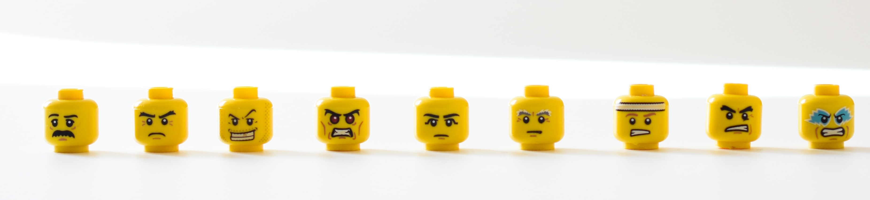
Managing emotions suggestions
Can you suggest any ways young people can manage the difficult emotions, mood swings and unpredictable reactions that sometimes occur during puberty?

Slide 16

Question box and signposting support
If you would like further guidance or support:
speak to a parent/carer, tutor, head of year, school nurse/counsellor or other trusted member of staff in the school
Visit:
A Better Medway: www.abettermedway.co.uk
Childline: www.childline.org.uk 0800 1111

Slide 17
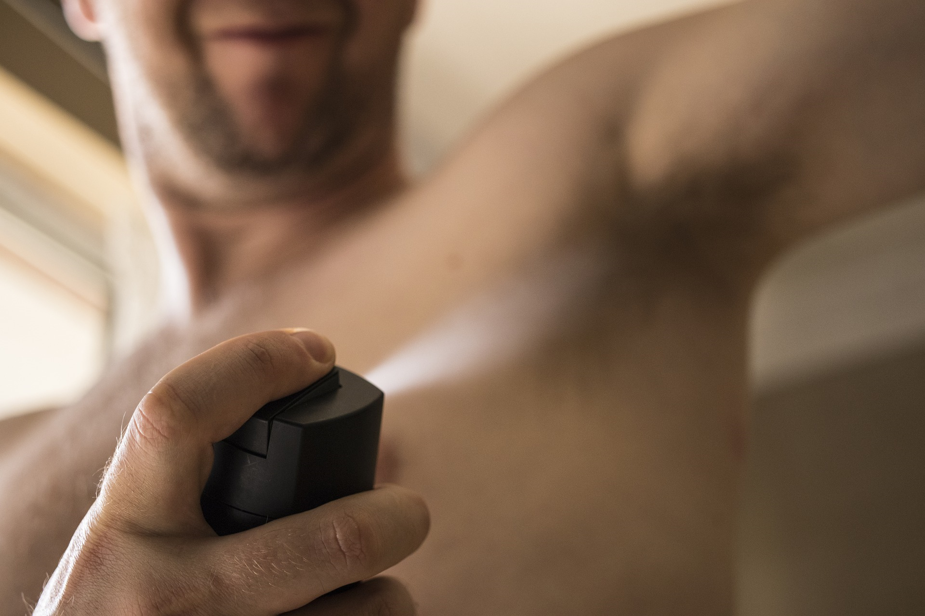
More activities
Puberty products
Look at some different products relating to puberty and discuss:
How might they be used?
Why might they be necessary?
Offering support
Return to the scenarios from the start of the lesson. Can you offer each character an appropriate source of support – who would be best for them to talk to and why?

