Slide 1
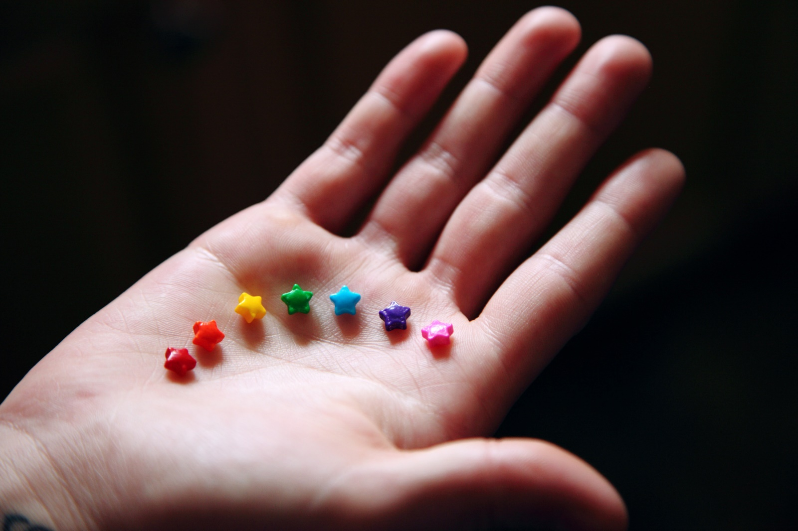
Sexual orientation and gender identity
LO: Lesson 4

Slide 2

Group Agreement
Notes:
Staff should go through this slide and create a group agreement in the first RSHE lesson of the academic year. It is recommended that this is done in the following way:
Discuss and agree as a group. Teacher creates the document in the template for all pupils to stick into book the next lesson.
The Group Agreement should then be visited during the start of each lesson along with the slides on Protected Characteristics, SMSC and British Values.

Slide 3
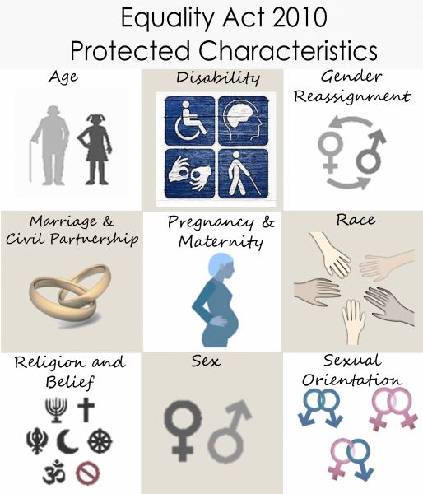
Protected Characteristics?
Protected characteristics are aspects of a person’s identity that are protected under the Equality Act 2010. This law makes it illegal to discriminate against someone based on these characteristics, helping to promote a fairer and more equal society.
Notes:
Teaching staff should go over the protected characteristics at the start of every lesson, and ensure that the language of the classroom reflects these characteristics.

Slide 4

At UALS we continually promote the values that underpin SMSC. These values form the foundations on which the RSHE curriculum has been designed and in the ways we teach and learn.
The concept of SMSC will be used to promote and develop our pupils understanding of British Values throughout their RSHE Learning Journey.

Slide 5
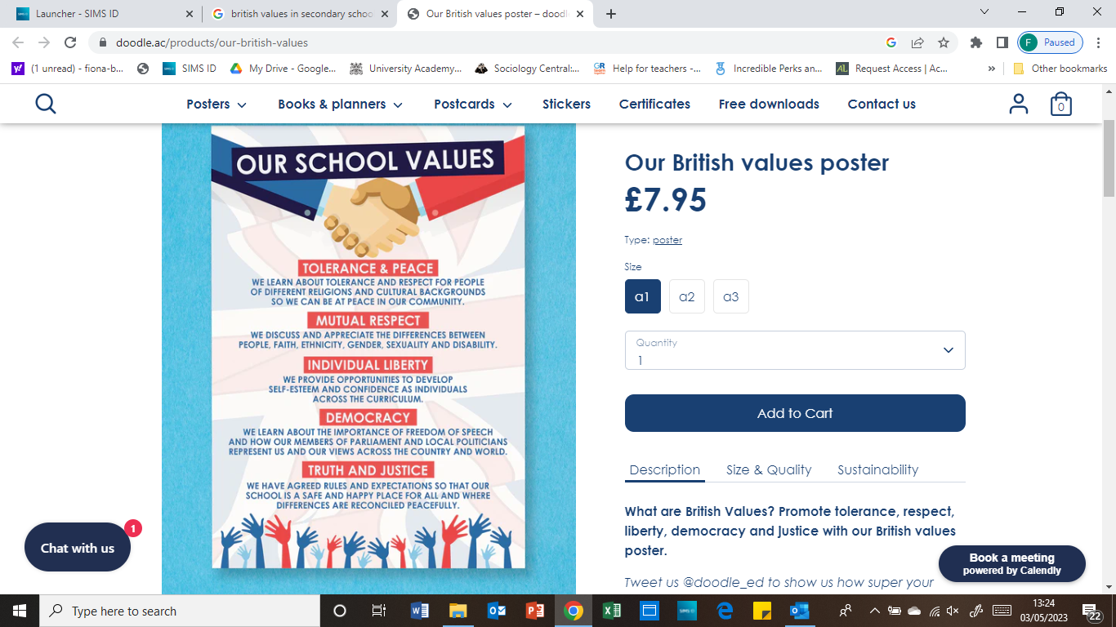
British Values in RSHE
Notes:
Teaching staff should talk pupils through this slide every lesson.

Slide 6
Last lesson | 3 | Influences on Relationship Expectations | Assess how to challenge unrealistic relationship expectations.
This lesson | 4 | Sexual Orientation and Gender Identity | to understand and respect the spectrum of gender identities and sexual orientations.
Next Lesson | 5 | Consent – Avoiding Assumptions | To evaluate common assumptions related to consent and how to challenge these

Slide 7
Overheard conversation
2. Why might both people have found the conversation difficult?
“My mate started talking to me about gender and sexual orientation. I think they were trying to come out to me or something, but I don’t really get the difference or know much about all that, so I changed the topic. I feel kind of bad now.”
1. What is the difference between sexual orientation and gender identity?
3. How could the person have responded to be more supportive of their friend?

Slide 8

Definition dominoes
Match the dominoes (begin with the card that says ‘start’)
To check the answers, I will nominate a pair to start by reading the right hand term on the card with ‘start’ on it
The next pair will state the definition which matches that key term. If it is right, they read their definition, and so on, until we reach the domino with ‘the end’ on it

Slide 9
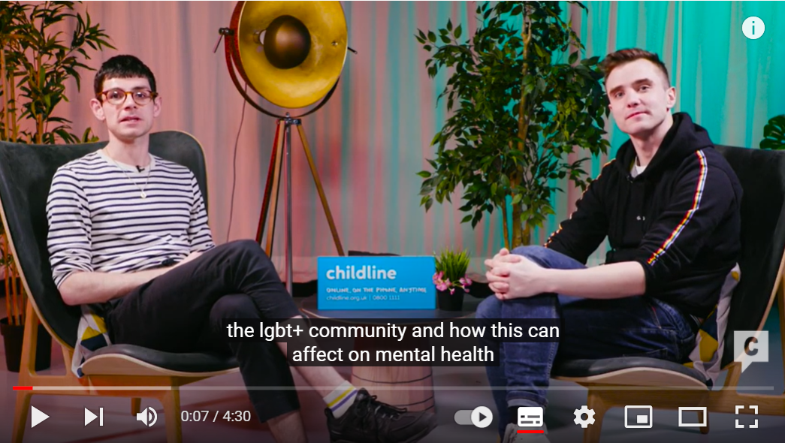
Video discussion
Watch the video and discuss how people can be made to feel supported when they talk to friends about their sexual orientation or gender identity.
Notes:
Click on the picture of the video or copy and paste this link into your web browser to access the video: https://www.youtube.com/watch?v=RHymPvtLlcA

Slide 10
Friend scenarios
For each speech bubble, consider…
1. What might the person be thinking and feeling as they say this to their friend?
2. What might a friend who hears this be thinking and feeling?
3. What might a friend be able to do or say to make the other person feel comfortable and supported?

Slide 11
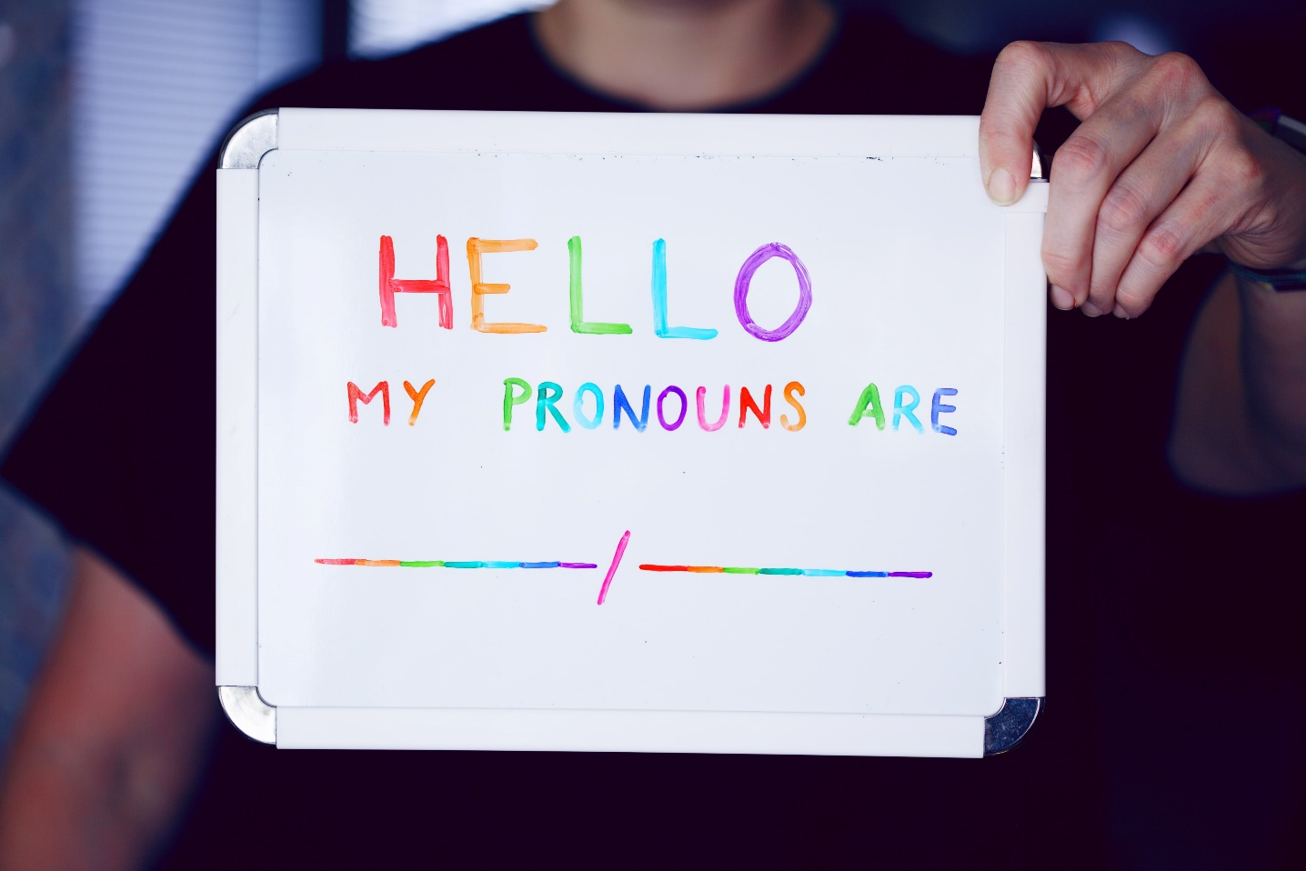
Private reflection
In silence, think about these questions:
How would someone (you or a friend) want to be supported if they told someone about their sexual orientation or gender identity?
What steps can you take to make sure everyone is treated equally and respectfully?
What further steps could our school take to ensure everyone is equally valued and supported?

Slide 12
Overheard conversations
2. Why might both people have found the conversation difficult?
Revisit your answers – is there anything you would add or change?
“My mate started talking to me about gender and sexual orientation. I think they were trying to come out to me or something, but I don’t really get the difference or know much about all that, so I changed the topic. I feel kind of bad now.”
3. How could the person have responded to be more supportive of their friend?
1. What is the difference between sexual orientation and gender identity?

Slide 13


Signposting support
If you would like further guidance or support:
speak to a parent/carer, tutor, head of year, school nurse/counsellor or other trusted member of staff in the school
Visit:
LGBT+ helpline: 0300 330 0630
A Better Medway: www.abettermedway.co.uk
Brook: www.brook.org.uk/help-advice
Childline: www.childline.org.uk 0800 1111

Slide 14

More activities
The law on ‘homosexuality’
Research the laws relating to ‘homosexuality’ and create a timeline to display this.
Gendered colours
Research the history of the colours pink and blue to designate babies’ sex in Western culture. You could focus on the origins of the practice, whether the colour designations have always been the same and the impact of the practice.
Celebrate LGBT History Month
How would you involve your class in planning celebrations for Lesbian, Gay, Bisexual, Transgender (LGBT) History Month held in February each year?
International day against homophobia, biphobia and transphobia
Plan and prepare an assembly to celebrate the International Day Against Homophobia, Biphobia and Transphobia on the 17th May.

