Slide 1

Relationships
Sexual

Slide 2
Learning Objective
To understand what a sexual relationship is, why people might form them and what makes them healthy, unhealthy and abusive.
Success Criteria
To know what is meant by a sexual relationship.
To identify the key differences between platonic, romantic and sexual relationships.
To identify reasons why people might form sexual relationships and whether these might be healthy or unhealthy.
To identify and understand healthy, unhealthy and abusive sexual relationships.
Why?
Many of us will engage in sexual relationships during our lives, whether this is alongside other kinds of relationships or not. It is therefore important to understand why we might engage in sexual relationships, what this might mean for us and how we can maintain them healthily. Furthermore, being able to decide what we want from relationships (sexual or otherwise) and learning to communicate this can help us to define our overall values in life, improve self-esteem and maintain healthy relationships in future.

Slide 3

Our Group Agreement
Notes:
Staff should go through this slide and create a group agreement in the first RSHE lesson of the academic year. It is recommended that this is done in the following way:
Discuss and agree as a group. Teacher creates the document in the template for all pupils to stick into book the next lesson.
The Group Agreement should then be visited during the start of each lesson along with the slides on Protected Characteristics, SMSC and British Values.

Slide 4
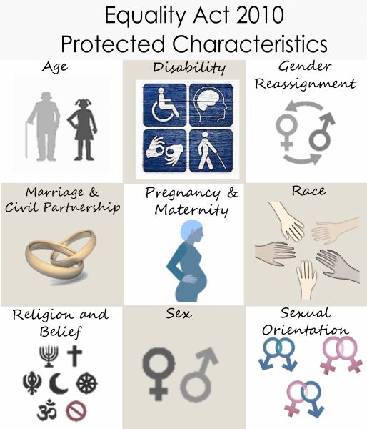
Protected Characteristics?
Protected characteristics are aspects of a person’s identity that are protected under the Equality Act 2010. This law makes it illegal to discriminate against someone based on these characteristics, helping to promote a fairer and more equal society.
Notes:
Teaching staff should go over the protected characteristics at the start of every lesson, and ensure that the language of the classroom reflects these characteristics.

Slide 5

At UALS we continually promote the values that underpin SMSC. These values form the foundations on which the RSHE curriculum has been designed and in the ways we teach and learn.
The concept of SMSC will be used to promote and develop our pupils understanding of British Values throughout their RSHE Learning Journey.

Slide 6
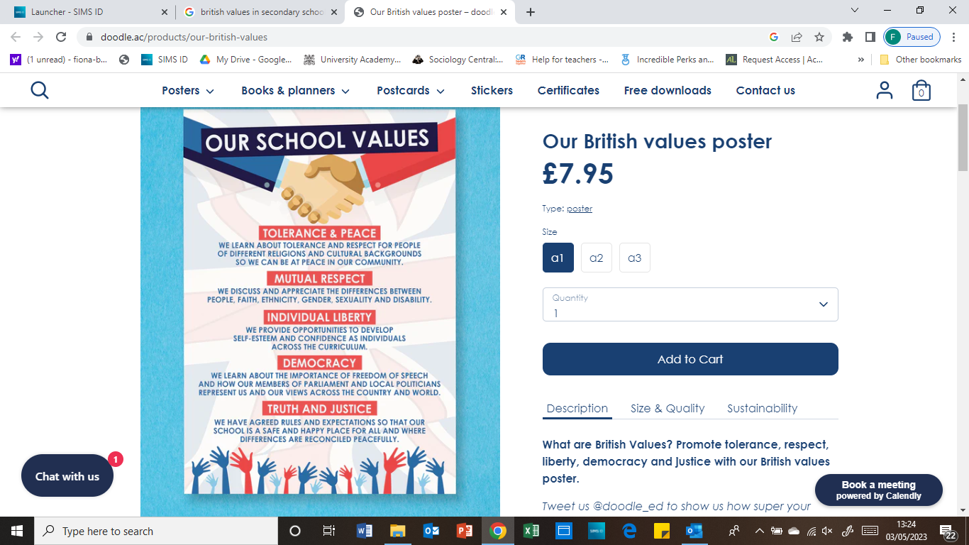
British Values in RSHE
Notes:
Teaching staff should talk pupils through this slide every lesson.

Slide 7

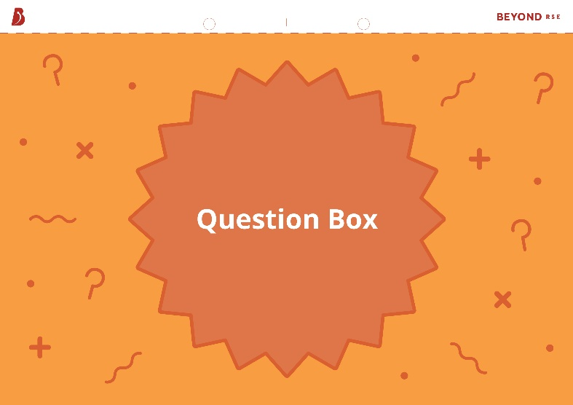
Question Box
If you have a question during this lesson that you don’t want to ask in front of everyone, write it down on one of the cards provided and put it in the question box.

Slide 8
Starter
Consider the following questions:
What might ‘sex’ mean to different people?
Why might people form sexual relationships?
What makes a sexual relationship healthy?
Remember that there are no set answers at this point!

Slide 9
Sexual Relationships
‘Sex’ can mean different things in different contexts. These definitions should help to clear things up a bit:
Sex – can refer to sexual activity, sexual intercourse or biological sex.
Sexual activity – intimate or physical activity by oneself or with others that is considered sexual by those involved. This might include kissing, sexual touching, oral, anal and vaginal sex.
Sexual intercourse – sexual contact between individuals involving penetration. This is just one type of sexual activity.
Biological sex – usually determined by a person’s biological genitalia, their reproductive systems, the sex chromosomes in their body and the hormone levels they produce.
Sexuality – made up of someone’s sexual feelings, thoughts, attractions and behaviours towards themselves and/or others. This is unique to them and their sexual orientation is just one part of this.

Slide 10
Sexual Relationships
‘Sex’ can mean different things in different contexts. These definitions should help to clear things up a bit:
Sexual relationship – a relationship involving sexual activity and/or intimacy.
Sexual attraction – having feelings of sexual interest or excitement towards another person or people, which may include wanting to have sex with them. Sexual attraction may or may not happen alongside another type of attraction.
Sexual orientation – a person’s identity in relation to the gender(s) or sex(es) they are sexually attracted to. This includes orientations such as homosexual, heterosexual, bisexual, pansexual and asexual. A person’s sexual orientation is not necessarily the same as their romantic orientation.

Slide 11
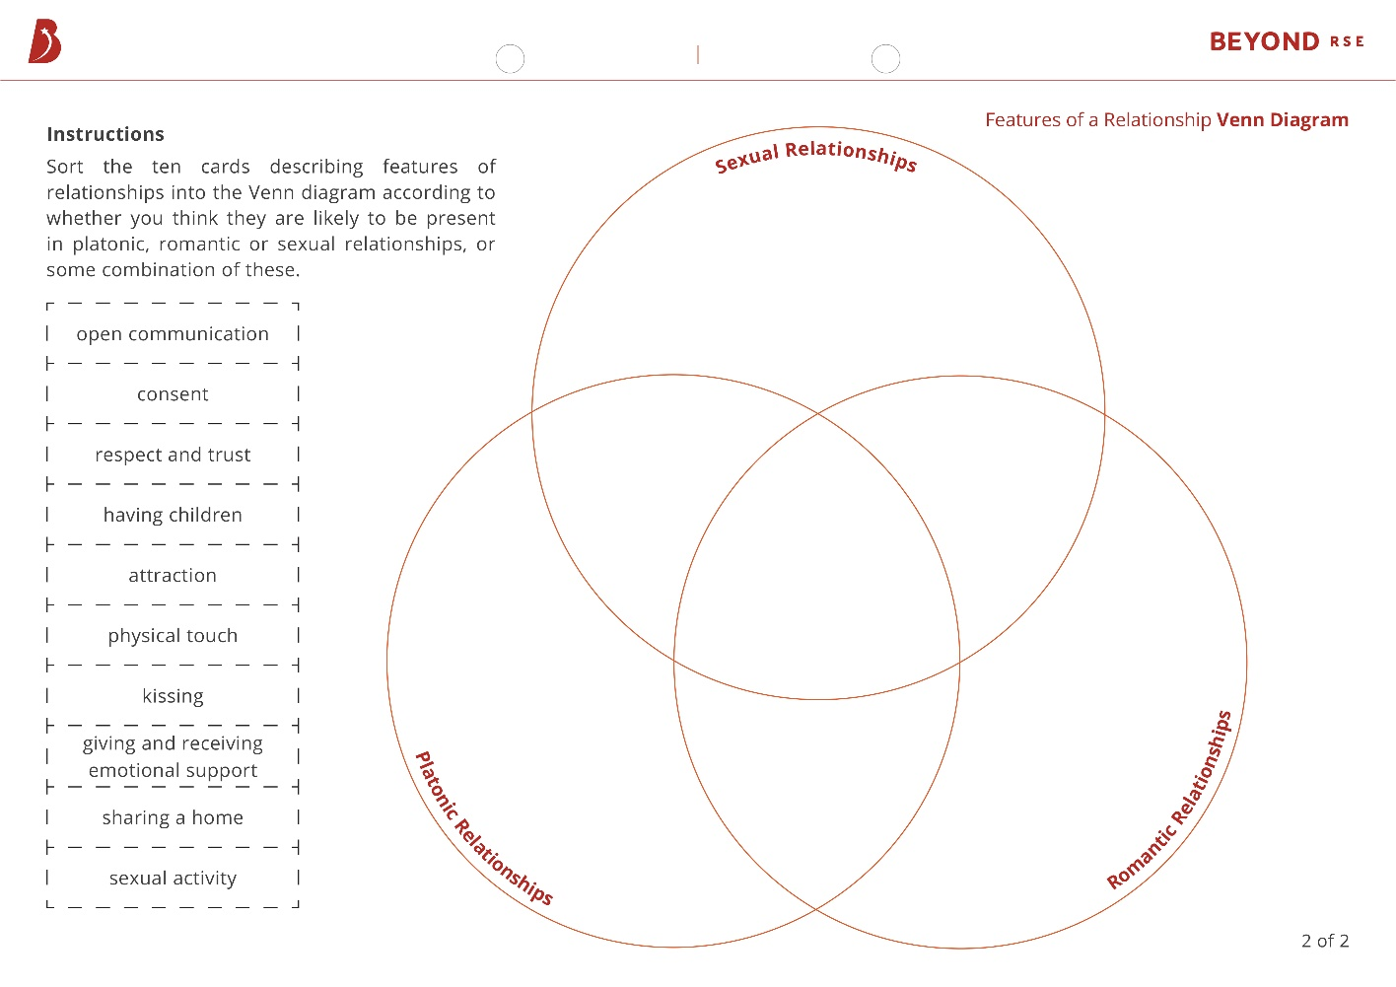
Features of a Relationship
Sort the ten relationship feature cards into the Venn diagram according to whether you think they are likely to be present in platonic, romantic or sexual relationships, or some combination of these.

Slide 12
Features of a Relationship
Open communication
Although this is usually associated with romantic relationships, communication is vital in all relationships as it lays the groundwork for many of the other features to be possible.
Consent
We might hear a lot about sexual consent, but it is important to seek and give consent for specific actions in all relationships.
Respect and trust
Respect and trust are not often associated specifically with sexual relationships, but they are just as important here considering the intimacy (and often vulnerability) that occurs within a sexual relationship. We should have basic levels of respect and trust with anyone we have any kind of relationship with.
Having children
This is often associated with romantic and sexual relationships, but many people in different kinds of relationships have children together. Furthermore, sexual intercourse is just one of many ways of having children.
Attraction
This might be romantic, sexual, platonic, physical or aesthetic (or a combination!)

Slide 13
Features of a Relationship
Physical touch
Intimate touching (e.g. touching thighs, bums, breasts, hips etc.) and being naked together are generally present in romantic and/or sexual relationships, but could also be in queerplatonic relationships. However, hugging and being physically close to one another could also be platonic.
Kissing
This may differ depending on whether it is on the lips, cheeks or other parts of the body and whether it is a quick peck or prolonged.
Giving and receiving emotional support
This is generally associated with platonic and romantic relationships, but could also be in a sexual relationship (especially if it is combined with other kinds of relationships).
Sharing a home
This could be in any relationship. It is often worth negotiating clear boundaries if you are planning to live with someone you are in a relationship with.
Sexual activity
This is not generally present in platonic relationships (but can be in queerplatonic relationships). Some people might also be romantic but not sexual in certain relationships, or vice versa.

Slide 14
Platonic, Romantic and Sexual Relationships
Platonic | Romantic | Sexual
Deep love or friendship, primarily based on companionship and shared interests and activities. | Deep, passionate love. | Usually characterised by lust, but can also involve love.
Not usually associated with strong feelings of nervousness or excitement. | Associated with strong feelings of nervousness and excitement, including ‘butterflies’. | Lust itself can be associated with strong feelings of excitement, which is why it might be confused with love in the early stages.
Does not involve sexual relations (unless it is a queerplatonic relationship, in which case it might). | Sometimes (but doesn’t have to be) alongside a sexual relationship. | A relationship must involve sexual intimacy to be sexual, but could be alongside another kind of relationship (e.g. romantic).
Often involves physical intimacy such as hugs and being physically close to one another (but doesn’t have to). | Often involves a level of physical intimacy that is not present in other relationships (but this is not always the case). This might include prolonged cuddling and holding, and kissing on the lips. | Involves sexual intimacy and potentially other physical intimacy too. This might include prolonged kissing on the lips, being naked together, sexual touching and massages.

Slide 15
Platonic, Romantic and Sexual Relationships
Whilst we are separating platonic, romantic and sexual relationships to understand similarities and differences, it is often the case that people combine these relationships in different ways depending on their wants and needs. The specific features of a relationship are determined by communication between those involved.
There are also plenty of other features of relationships in addition to the ones in this activity!

Slide 16
Sexual Relationships
Having sexual relations with another person or people might be one aspect of a relationship which involves many other things, such as romance, shared interests or living together.
Sex might also be a way for people within another kind of relationship (e.g. a romantic relationship) to take their feelings for each other further or show their love for each other.
However, not all romantic relationships have to lead to sex, and many don’t. This depends on the people involved communicating about what they want from the relationship.
Alternatively, some people may choose to have relationships that are only sexual. This is also fine.

Slide 17
Sexual Relationships
Whether we choose to combine a sexual relationship with another kind of relationship or not, it is important that the people involved are in agreement, and any changing desires or feelings are communicated clearly.
Furthermore, ‘casual’ doesn’t have to mean ‘cold’. Although some relationships which are only sexual might be considered less serious by those involved (e.g. friends with benefits, casual sex with multiple different people), it should not mean that they treat each other with any less respect than they would anyone else.
Within sexual relationships, like in any other relationships, it is vital to maintain open communication, respect and kindness.

Slide 18

Reasons for Sexual Relationships
The following cards depict a number of different reasons why people might engage in sexual relationships.
Can you identify whether these reasons could be healthy, unhealthy or both? What might this depend on?

Slide 19
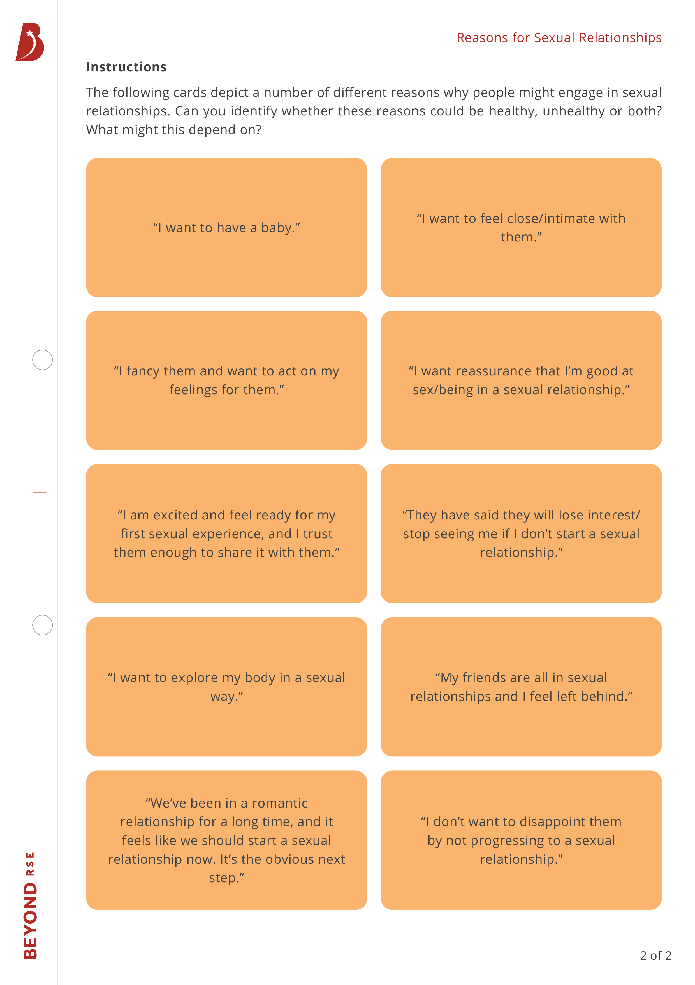
Reasons for Sexual Relationships

Slide 20

Reasons for Sexual Relationships
There are plenty of different ways to have children (with and without sexual intercourse).
Having sex is one of many ways of expressing feelings or being close to someone, and sexual intercourse is just one form of sexual activity, so there are plenty of options if someone isn’t ready for sex or a specific sexual act.
A person can explore their own body sexually without anyone else being present or involved. This is called masturbation or self-pleasure.
Not every romantic relationship has to be sexual, and many aren’t.
People engage in sexual relationships at their own pace and many people choose not to. It is important for each individual to do what is best for them and for their decisions to be respected by others.
Seeking sexual relationships just to feel better about ourselves could be a sign of low self-esteem. This is why it is important to think about the reasons behind wanting a sexual relationship.
Pressurising someone into sex or making them feel guilty for not wanting to have sex is never okay.

Slide 21


Deciding Whether to Start a Sexual Relationship
Deciding whether to start a sexual relationship might involve weighing up multiple different reasons. For example, in Aria’s situation:
On the one hand, I want to express my love for my girlfriend, but on the other hand, I am worried that she will stop being interested in me if I don’t progress to a sexual relationship with her soon.
If Aria isn’t ready to have sex with her girlfriend, she could try communicating this to her and suggesting that they try alternative forms of closeness such as kissing, cuddling and massages. Her girlfriend should understand and respect this, as it is never okay to put someone under pressure to have sex.

Slide 22
Deciding Whether to Start a Sexual Relationship
We have explored some of the reasons why people may choose to engage in sexual relationships, however there are many more. Some of the key things to ask ourselves when deciding whether to engage in a sexual relationship are:
Is this something that I want to do for me, or is it as a result of peer pressure?
How do I think I will feel after? Is this something that is likely to make me feel good about myself and have a positive impact on me, or a negative one?
Is everyone involved happy, in agreement and fully consenting? This is a must!
Do I trust the person or people that I'm thinking about doing this with?
Remember that it is always okay to change our minds; for example, if we start a sexual relationship and decide that it is actually not what we want or we are doing it for the wrong reasons.
Although it might be frustrating to be on the receiving end if someone changes their mind about this, we should absolutely respect the decision and avoid making anyone feel guilty or putting pressure on them to do things that they don’t want to.
Consent is key, and sex is never something that anyone should be pressurised into.

Slide 23
Age of Consent
In the UK, the legal age of consent is 16.
This means that, legally, a person under 16 cannot consent to sexual activity because they are seen as not having the capacity to do so. The law applies to everyone, regardless of gender or sexual orientation, in England, Wales, Scotland and Northern Ireland.
It is important to remember that the law is designed to protect young people from abuse, harm or being taken advantage of. If someone is under the age of 16 and decides to have sex anyway, it is still vital that them and their partner(s) consent to sex in every other capacity.
In the eyes of the law, someone under the age of 13 is not seen as old enough to consent to sex. Any sexual activity with someone under 13 is illegal and viewed as rape, sexual abuse or assault. If you are under the age of 13 and thinking of having sex, it is a good idea to talk to someone you trust first about this.

Slide 24

Healthy Sexual Relationships
It is important to consider how we might go about maintaining healthy sexual relationships.
Whether we are engaging in sex alongside another kind of relationship or having a relationship that is only sexual, it is still important that it is done in a healthy way.

Slide 25
Healthy Sexual Relationships
Five key features that are especially important in maintaining healthy sexual relationships are:
Open communication
Consent
Respect
Trust
Kindness
But how might these look in practice?

Slide 26

Healthy Sexual Relationships
Open Communication
Consent
Respect
Trust
Kindness
Focusing on one of the five features, consider how this might look in practice. You might find it useful to think about the following questions to help you:
What are some specific examples of how this feature might look in a relationship?
Can you think of any scenarios where this feature might be particularly important? How might they play out in a healthy relationship?
Are there any particular phrases that could be used to communicate this feature within a relationship?

Slide 27
Unhealthy and Abusive Sexual Relationships
Behaviours that are healthy, unhealthy and abusive in relationships all exist on a spectrum, meaning that lines can often be blurred.
Generally speaking, unhealthy sexual relationships involve one or more partner(s) exhibiting behaviours which are not healthy or founded in mutual respect, whereas abusive sexual relationships involve one or more partner(s) treating the other(s) with cruelty or violence, especially regularly or repeatedly (but not always).
All relationships are different, and sometimes what is healthy for one relationship might be unhealthy for another, or what is unhealthy for one might be abusive for another, and vice versa.
While everyone does unhealthy things sometimes, it is important to acknowledge when this happens and talk openly about it. Communication and agreeing what a healthy relationship looks like to the people involved is key.
If one aspect of your relationship isn't healthy, it doesn't mean that your relationship overall is unhealthy, for example some relationships might be excellent with communicating but not so good with independence. If there’s something you’re not so good at, discuss and work towards being better together.
It is also vital not to ignore unhealthy signs and to understand that these can escalate to abuse.

Slide 28
Unhealthy Sexual Relationships
Some features of unhealthy sexual relationships might include:
Poor communication – the wants and needs of partners aren’t discussed at all, or when they are, the discussions quickly turn into arguments.
Little or no respect.
Manipulation – controlling another person to get a desired outcome.
Criticism, belittling and putdowns – when someone does and says things to make you feel bad about yourself.
Humiliation/embarrassment.
Threats/intimidation.
Intensity – expressing extreme feelings or over-the-top behaviour towards someone that can feel overwhelming for the person on the receiving end.
Betrayal – being disloyal or acting in an intentionally dishonest way.

Slide 29
The Impact of Sexual Relationships
Sexual relationships often involved an increased level of intimacy and vulnerability and for this reason, what happens in sexual relationships might impact us more than what happens in other kinds of relationships.
Sex can be a very personal thing to share with someone, which is why it is important to think about who you are sharing this with and whether you trust them in this context.
This doesn't necessarily mean only having sex as part of a romantic or monogamous relationship – it might just mean ensuring that you feel respected by the person or people that you’re doing it with.
If you feel affected by something that happens in a sexual relationship, this is completely normal and valid, even if it was more casual. Give yourself time to process the situation and come to terms with your feelings.
There isn’t necessarily a ‘right’ or ‘wrong’ way of doing sexual relationships. What is important is that we reflect on our own sexual relationships to figure out what works best for us. The more we get to know ourselves in this respect, the more we can let this inform how we might approach sexual relationships in future.

Slide 30
Abusive Sexual Relationships
Abuse within sexual relationships might look like:
Mistreatment – treating someone with cruelty or violence.
Gaslighting – manipulating someone into doubting their own sanity.
Using violence or force.
Coercive control – an act or a pattern of acts of assault, threats, humiliation and intimidation or other abuse that is used to harm, punish or frighten.
Sexual assault – any specific sexual act which a person does not consent to or which they are forced into. It is a criminal offence.
Denying their abusive actions are abusive.
Danger – not feeling safe within the relationship.
Remember that unhealthy relationships can and do easily escalate to abusive relationships, and it can be tricky to recognise this when you are in that situation. If you are in any doubt about yourself or someone else, the safest thing to do is speak to a parent, teacher or a professional service about it.


Slide 31
Ending Sexual Relationships
Sexual relationships might end for many reasons, for example:
partners growing to be different or wanting different things from the relationship;
other aspects of the relationship aren’t working;
cheating or breaking the rules of the relationship;
there are differing feelings towards each other which can't be managed effectively (for example if one person’s feelings have changed).
The ending of sexual relationships can be incredibly difficult, especially considering the kind of intimacy and vulnerability that is often involved in them. It is especially hard if it is something that we feel we don’t want to do, but have to for the benefit and wellbeing of those involved.

Slide 32
Ending Sexual Relationships
We should try our best to maintain a level of respect and understanding if we are ending a sexual relationship on good terms, so that we don’t cause unnecessary pain. This might include:
discussing feelings in person;
being truthful and honest;
listening to what is being said by the other(s);
allowing a certain amount of time before speaking again, if you are interested in having a more casual relationship in future.
If we want to end a sexual relationship with someone, it is important to be open and honest about this. Although this might be difficult, it is kinder than stopping talking to them without any explanation (sometimes called ‘ghosting’), as this is likely to cause far more confusion, pain and upset.


Slide 33
Plenary
Revisit the questions you thought about at the beginning of the lesson. Have your answers now changed? Note down anything else that you have learnt about sexual relationships from this lesson.
What might ‘sex’ mean to different people?
Why might people form sexual relationships?
What makes a healthy sexual relationship?

Slide 34

Questions?

Slide 35
Further Help

Slide 36


